Slide 1
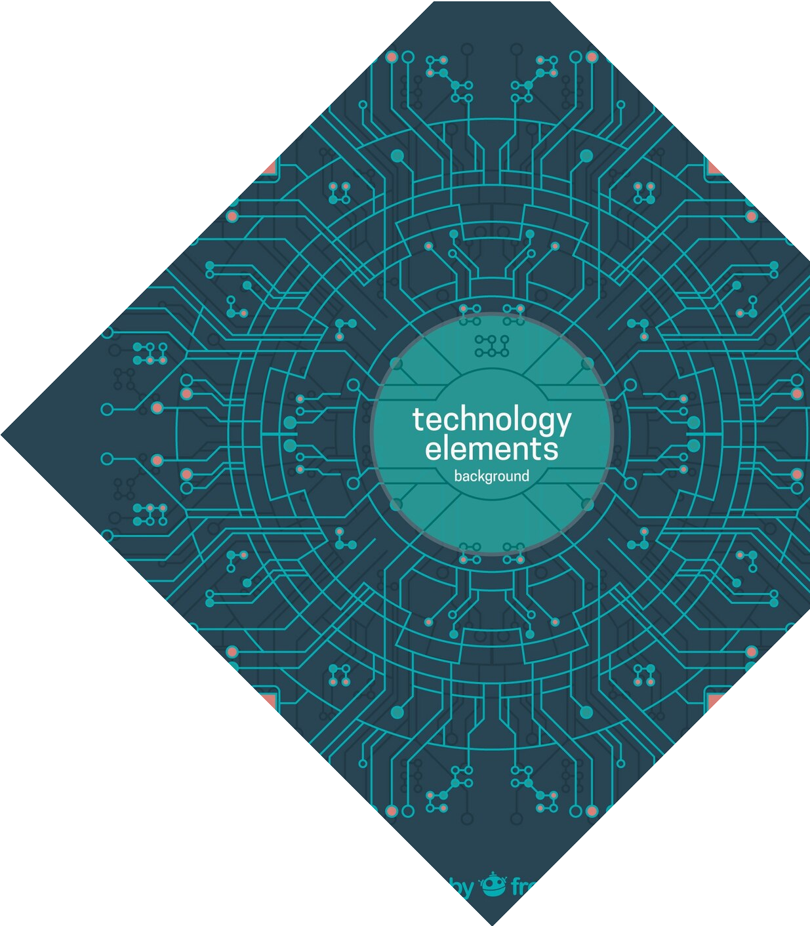
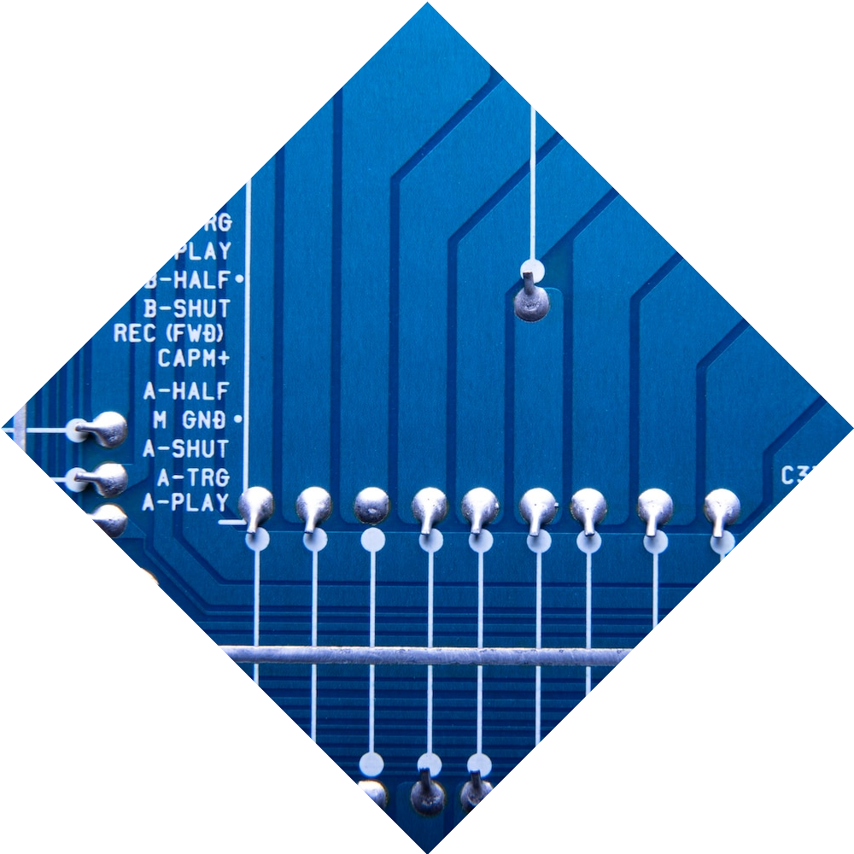
Internship Project Defense: Designing a GPS with 8051 Microcontroller
Name: Josephine Oduatyo Eyituoyo Odusanya
Major: Robotics Engineering
Presentation day: 23/01/2024

Slide 2
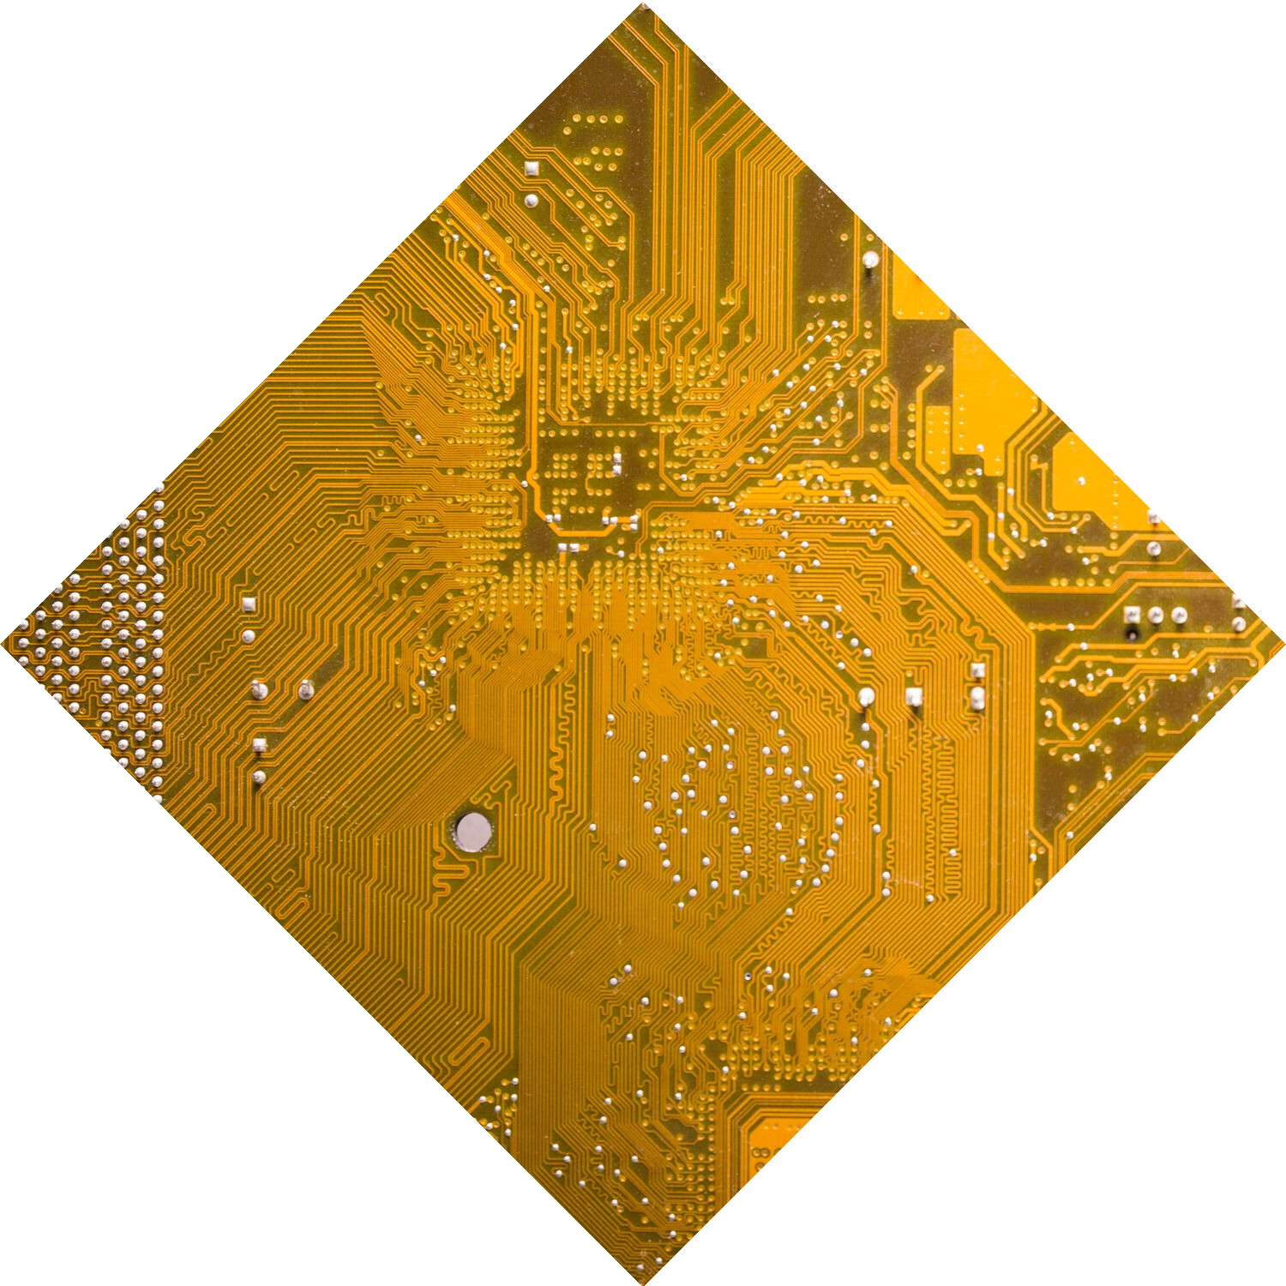
Introduction
In this presentation, we talk about the project undertaken during the internship: the GPS design with 8051 Microcontroller.

Slide 3

Understanding GPS
Technology
“GPS, or the Global Positioning System, is a global navigation satellite system that
provides location, velocity and time synchronization” (Geotab, 2020).
The GPS came about because the United States Department of Defense initiated the
development of a system to enhance military navigation capabilities.

Slide 4


GPS answers five questions simultaneously: “Where am I?” “Where am I going?” “Where are you?” “What’s the best way to get there? “When will I get there?” GPS is the only system today that can show your exact position on the Earth anytime, in any weather, no matter where you are!

Slide 5


Real-world Applications
Agriculture
Aviation
Navigation and Mapping
Emergency Services
Geo-caching and Recreation

Slide 6
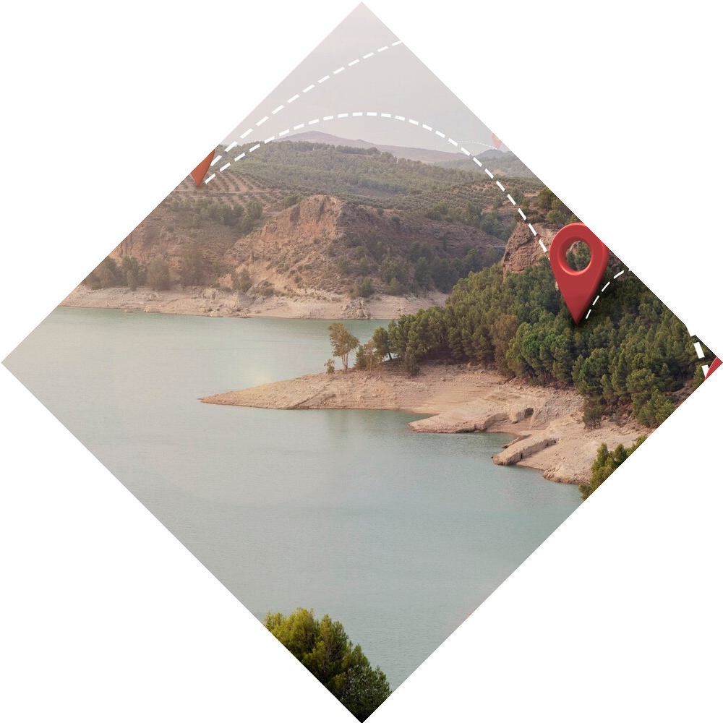
Project Overview
LCD
GPS Signal
STC89C52 Microcontroller
GPS Module
Power Supply

Slide 7
Hardware Circuit

Slide 8
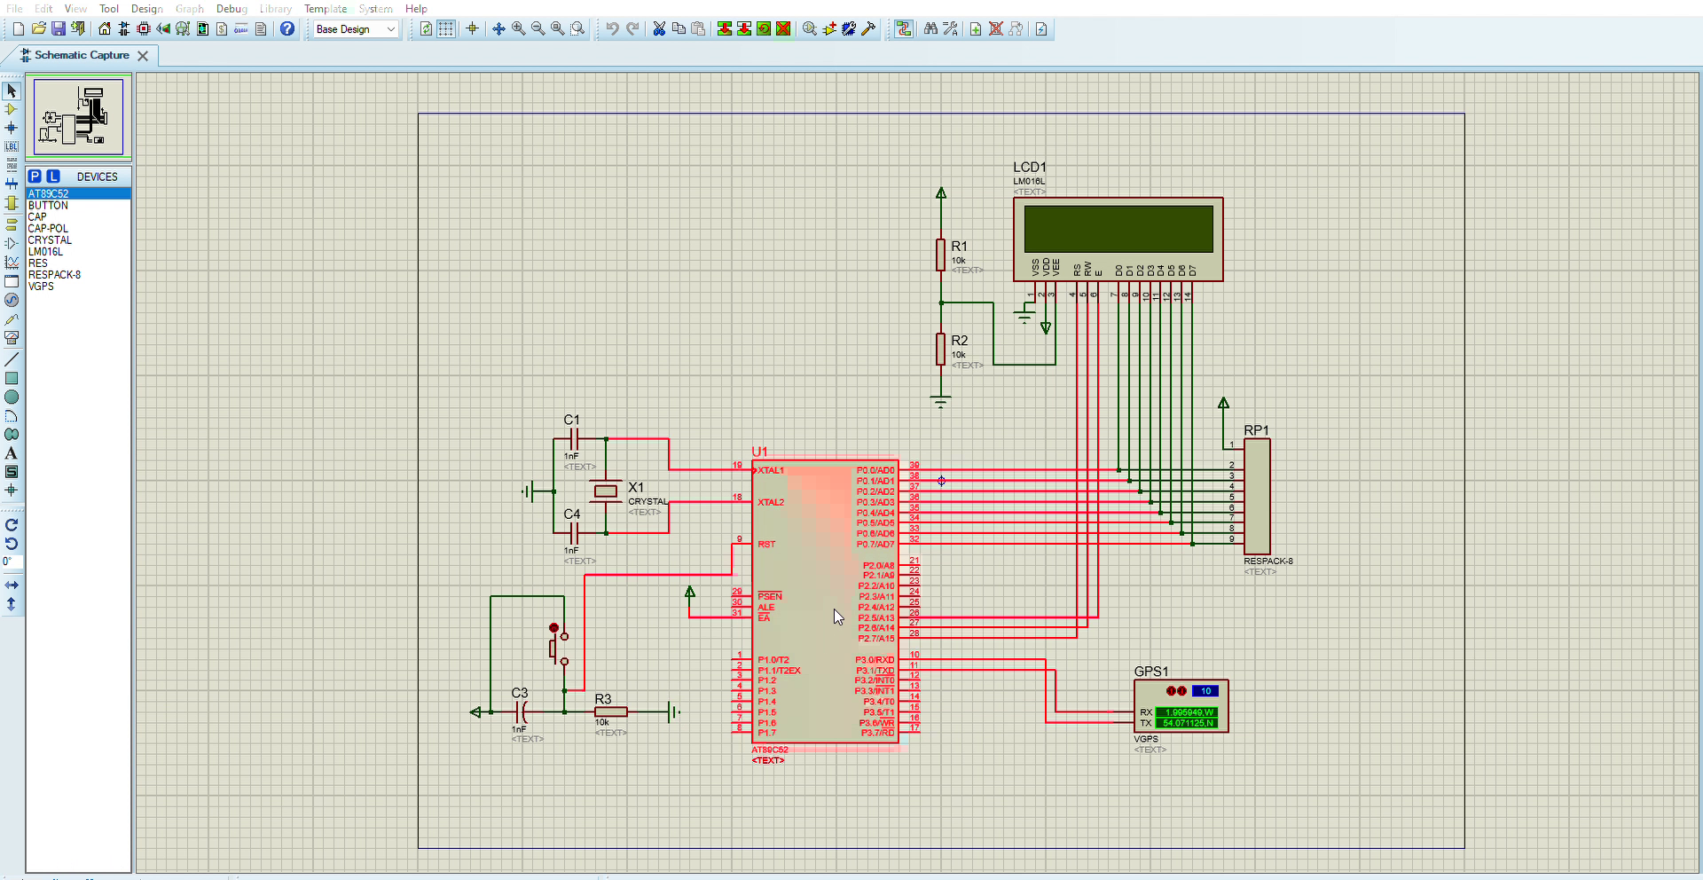
Proteus Simulation

Slide 9
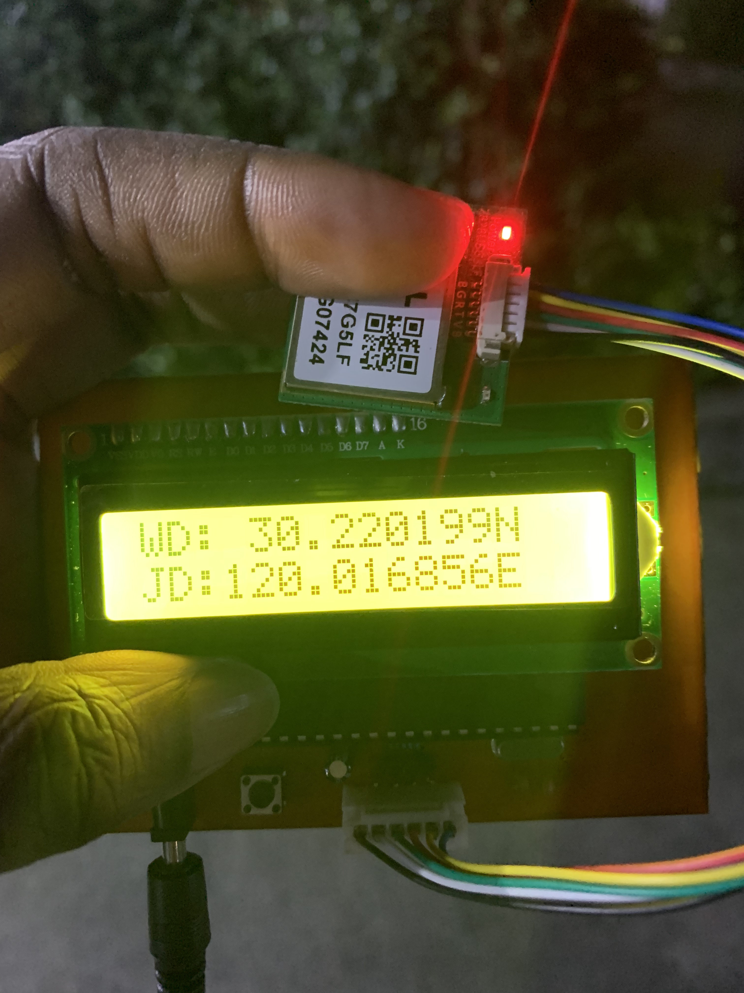
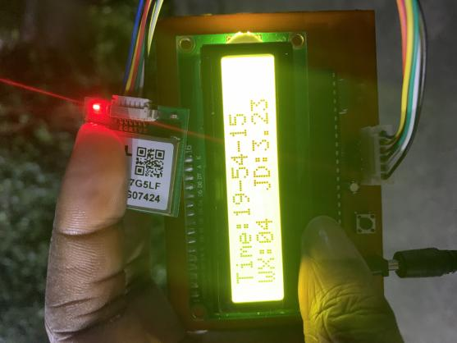
Prototype

Slide 10
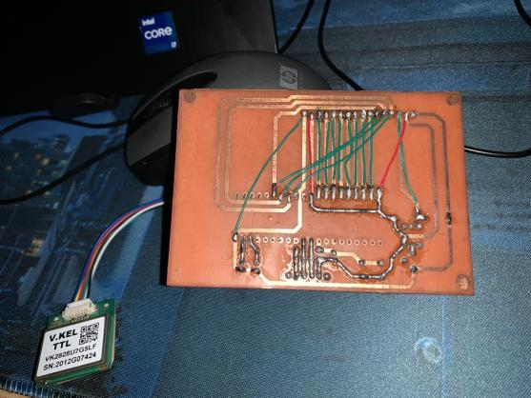
Prototype

Slide 11
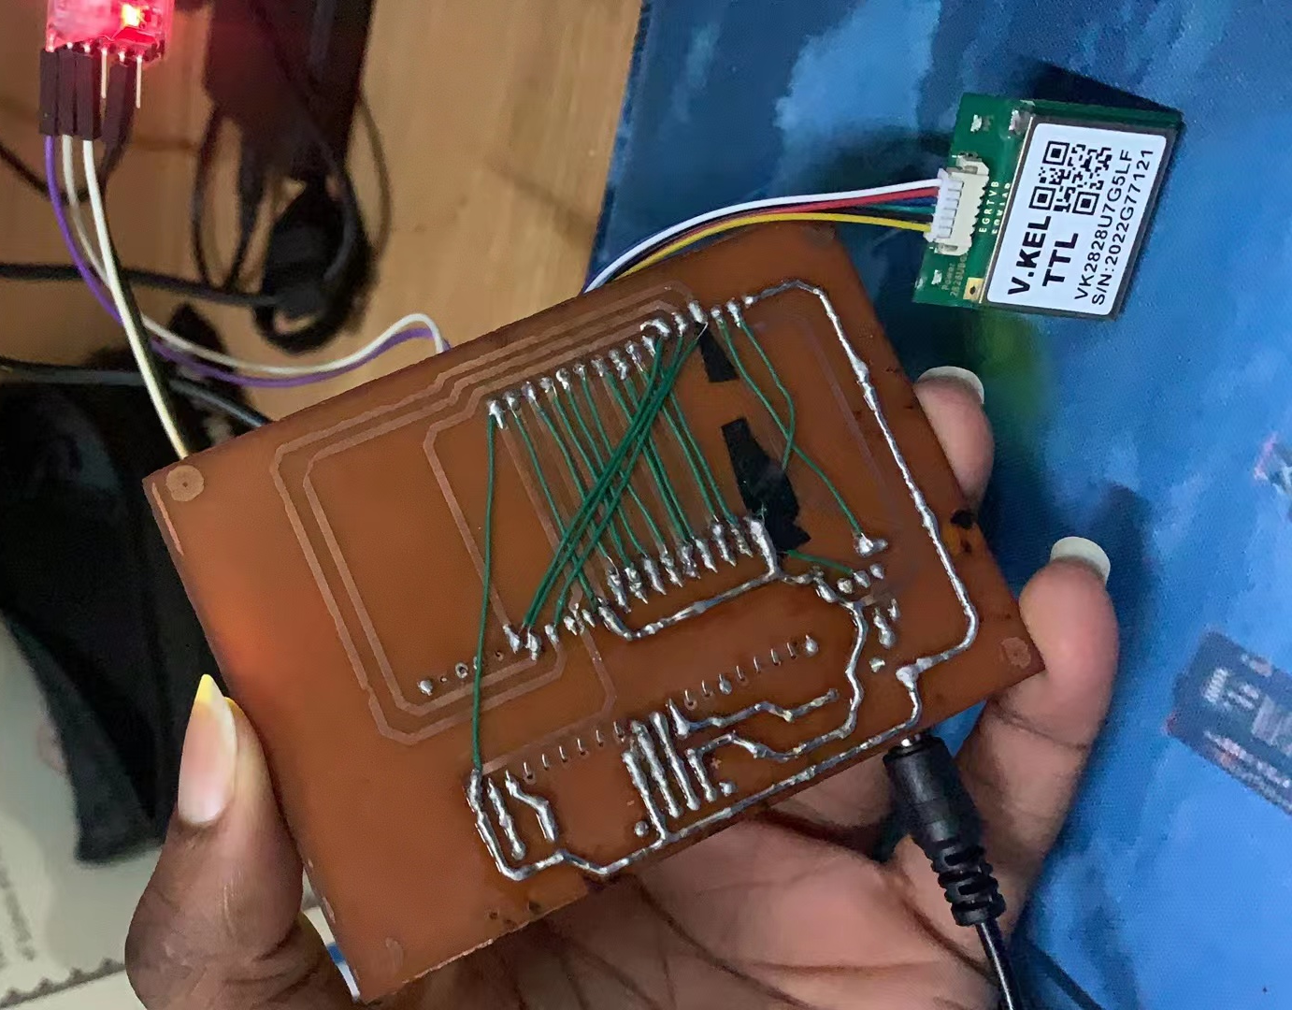
Challenges and Solutions

Slide 12
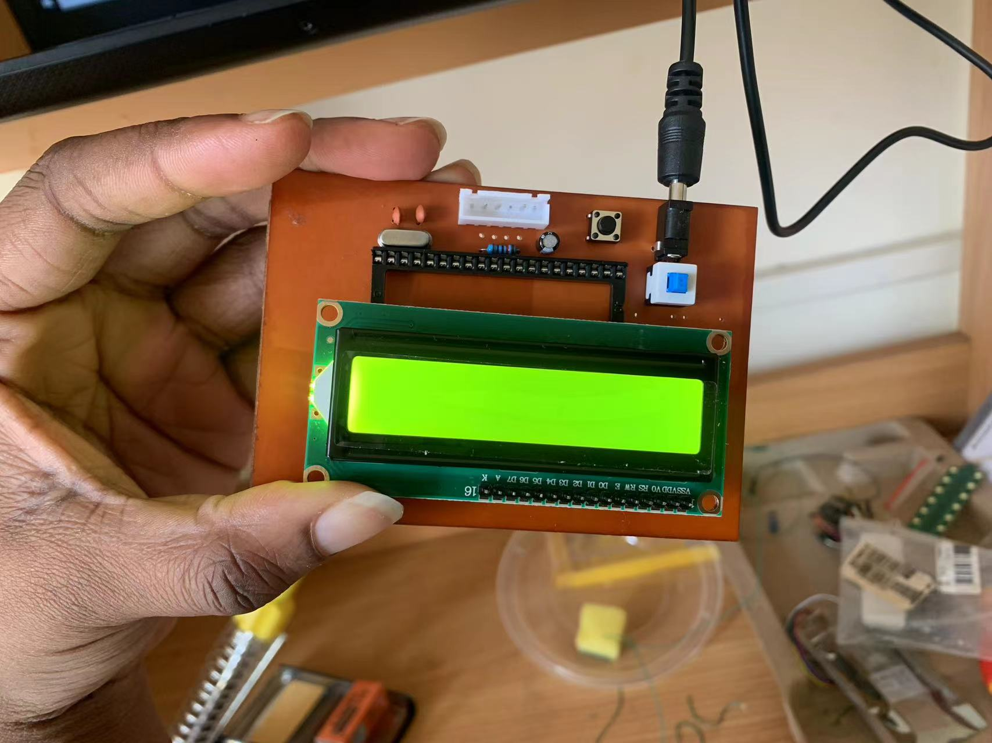
Challenges and Solutions

Slide 13
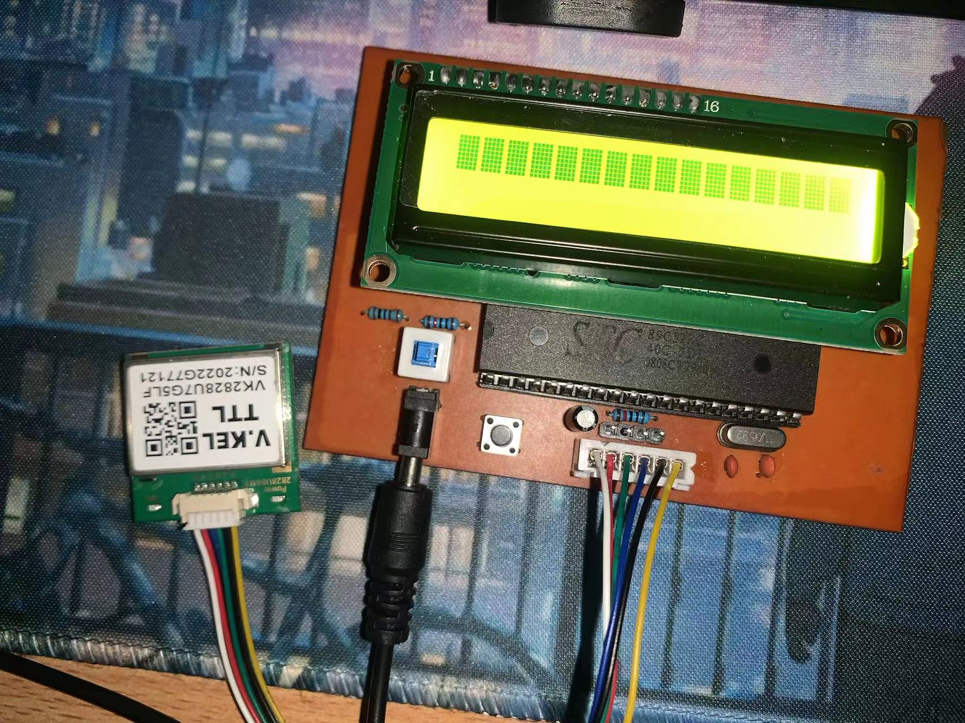
Challenges and Solutions

Slide 14
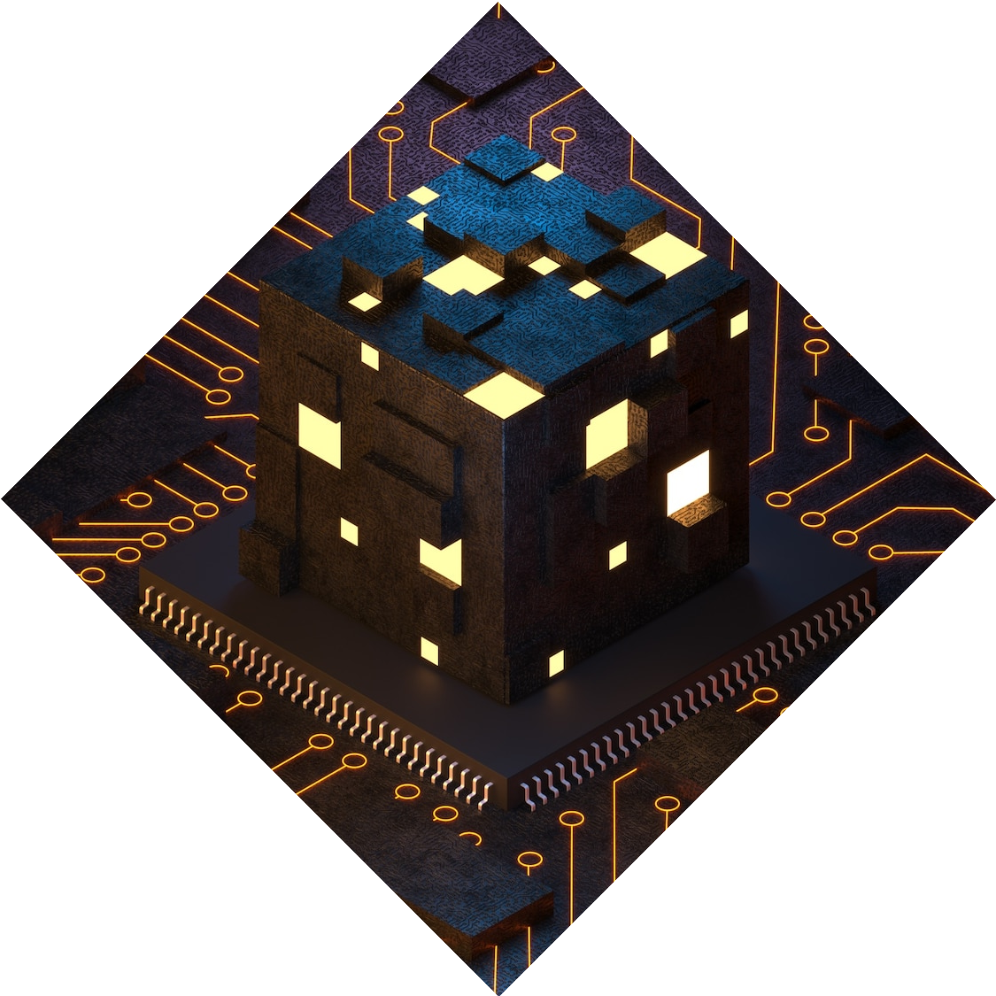
Potential Improvements and Other Considerations
SLAM
GPS Antenna
Autonomous Navigation
AI
Notes:
Something to consider in the future is using a stronger gps antenna to ensure a better signal transmission.

Slide 15
Conclusion
During my internship, I had the unique opportunity to contribute to the design of a GPS based on the 8052 microcontroller. This experience was particularly exciting for me as it marked my first foray into soldering, a skill I had not previously acquired. I am grateful for the flexibility that allowed me to complete my internship within the school environment, especially given the challenges in securing an external placement. Being immersed in the practical aspects of robotics has been a privilege, and having access to materials under the guidance of grounded and experienced professors enriched my learning experience. Overall, this internship provided a hands-on introduction to hardware design, expanding my skill set in this field.

Slide 16

Q&A!

